Slide 1




ADAPTIS
Working With You to Deliver More.
Notes:
Grüazi, we are Adaptis
The team behind the pioneering software solution designed to transform the service industry
Adaptis is our technological answer to the ongoing and ever present labor shortage and Adaptis is our technological answer, laying the foundation for autonomous robots in the service sector.
We believe robots powered by Adaptis can support staff, increase efficiency, and promote fair labor practices.
To illustrate our approach, let's first walk you through a hypothetical restaurant scenario, demonstrating one of our agents in action.

Slide 2
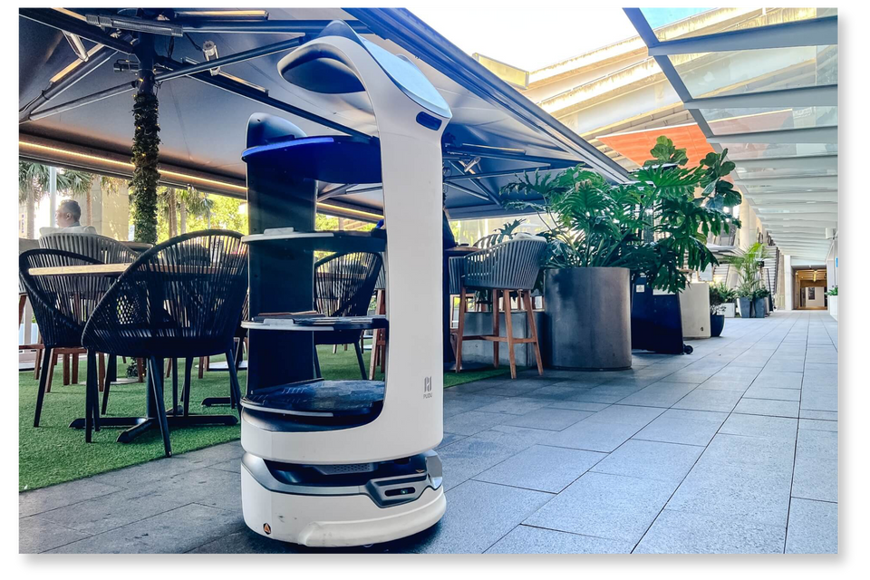
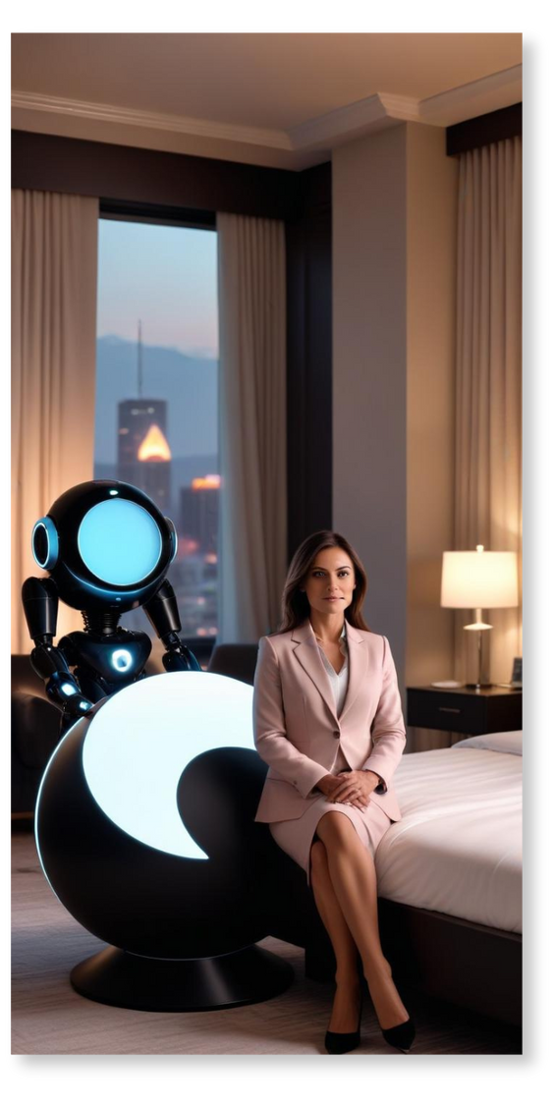
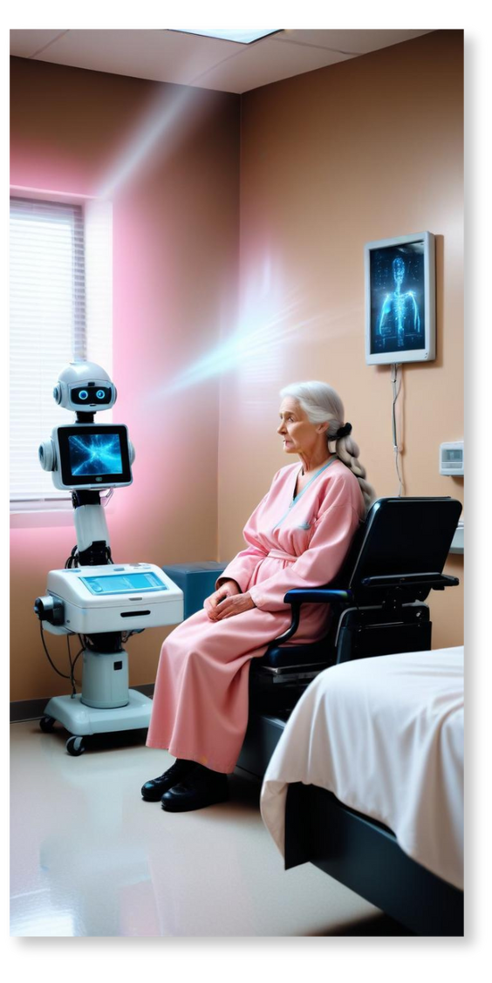
Tackling the labor shortage with...
RestauPal
MarriottMate
CareBot
Provides fast and efficient service, support, and order-taking to keep the restaurant cheap and efficient.
Provides warm welcome and personalised assistance to every guest, from checkin to trip planning.
A gentle companion, supporting staff and accompanying residents in nursing homes.
ADAPTIS
powered by
Notes:
What you just saw is only one of many possible applications in the service industry. Adaptis can be integrated with systems across various sectors, offering a unique opportunity to disrupt the way we think about service delivery.
In addition to our dear RestauPal, Adaptis-powered bots are already present in the hotel industry, where they streamline guest experiences. This not only results in smoother interactions for guests but also offers opportunities for businesses in the tourism sector to promote themselves more effectively.
Beyond the vacation industry, Adaptis agents can provide tremendous benefits in more sensitive applications, such as elderly homes or hospitals, where labor shortages are often most pronounced. Robots in these settings can do more than just deliver food to patients; they can also provide companionship, improving the overall quality of care.
From these examples, it is clear that we have laid the foundation for a robust fleet of autonomous assistants across many domains. This is made possible by the technical rigor behind Adaptis, which ensures the system can seamlessly integrate into various industries.

Slide 3
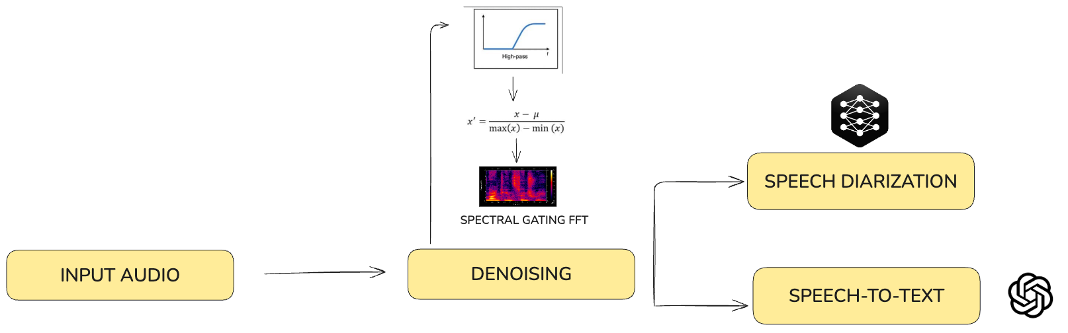


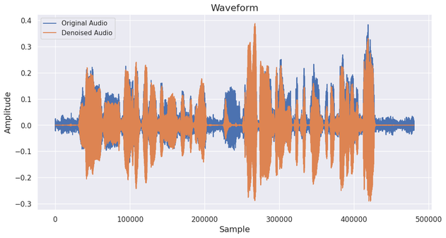
Technical Flow Diagram
Audio Enhancement
We support multiple speakers in
a single message
3
Notes:
From the previous use-cases it has become clear, that these robots have to be able to act in the most difficult of environments which are often noisy, with many people speaking at the same time and various sources of background noise, especially at restaurants and hotels.
For this reason we have .....
Here we want to quickly show the capabilities of our multi-stage de noising algorithm...

Slide 4
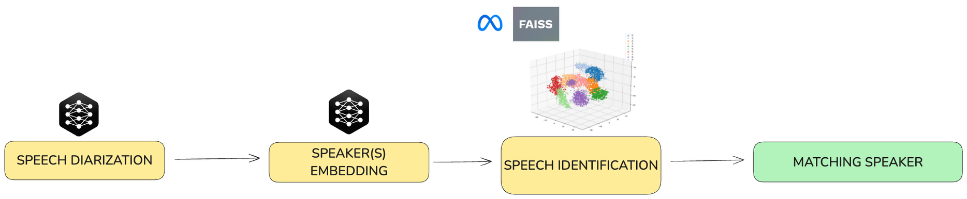




Technical Flow Diagram
Audio Enhancement
2. Speech Seperation and Speaker recognition
0.23
0.16
0.31
0.80
4
Notes:
Furthermore not only is it difficult to work with audio data containing multiple peoples voices, because the main speaker must be identified
...
but such a situation also offers a unique opportunity as being able to parse the voices of multiple people at once and recognizing/labeling them as such, is a big benefit for usability
...
to achieve this... we use .... a multi step ....

Slide 5
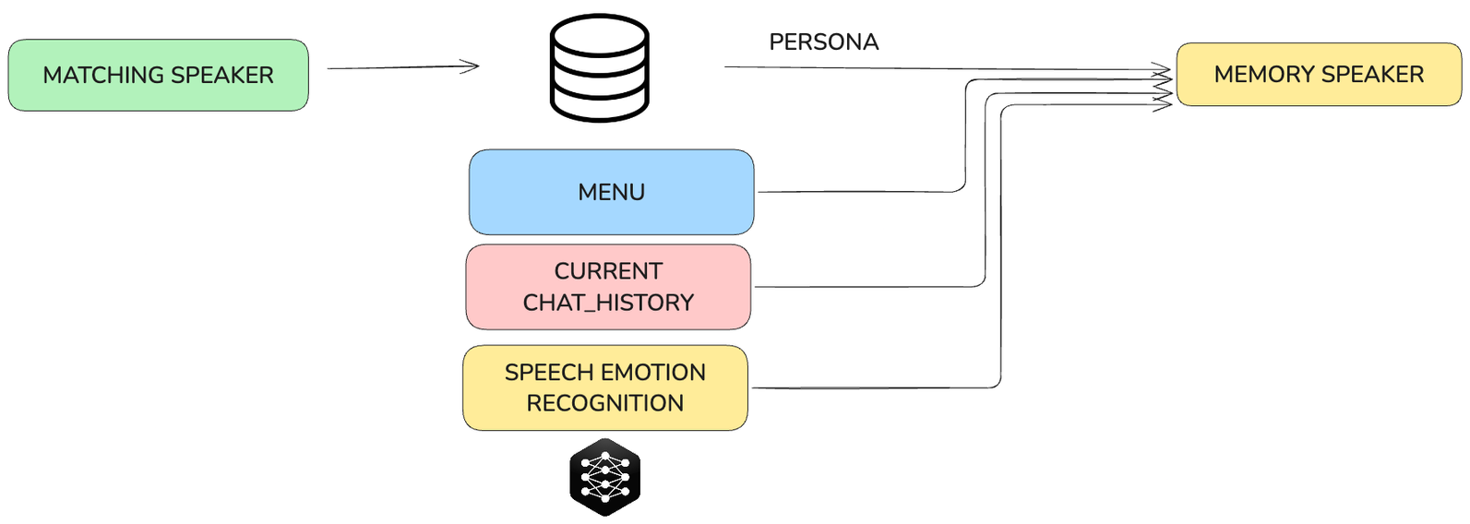
Technical Flow Diagram
Audio Enhancement
2. Speech Seperation and Speaker recognition
3. Extract relevant information and Emotions + Context + Menu
5
Notes:
Finally, for a truly personalized experience , especially in positions where people are in contact with these robots for longer periods of time, it is essential for the bot to recognize and remember any given person, their needs and preferences.

Slide 6


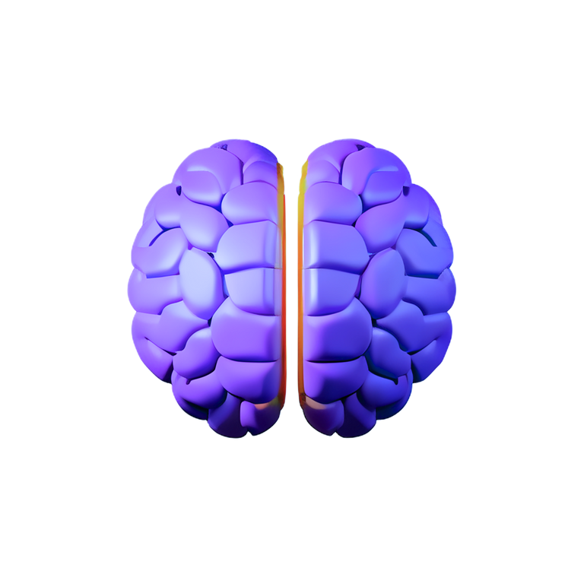

The Product
Customizable Intelligence for Today’s and Tomorrow’s Challenges
Seamless Conversations
Memory that
won’t forget you
On-Device
Computation
A personal experience and privacy gates to make sure your experience stays yours
powered by
ADAPTIS
6
Notes:
To summarize:
Adaptis offers audio only functionality that many multi-model devices with vision and audio capabilities struggle to compete with
and through this.. we ensure ... seamless conversations with the customer .....

Slide 7

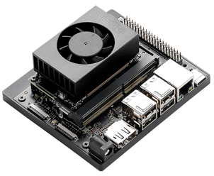
Limitations & Roadmap
Confidence in voice recognition
LLM Hallucinations
Function calling with internal system
NVIDIA Jetson Nano Integration
Adoption across
Domains
Encryption of embeddings
Speech Disability
Support
7
Notes:
However, this market is growing fast, and with AI innovation accelerating at speeds never seen before, we are dedicated to continuously extend Adaptis with state-of-the-art functionality to tackle problems like ....
... as effectively as possible
... furthermore ...

Slide 8
THANK YOU!
Mauro Leidi
Research Engineer
EPFL alumni
Gioele Monopoli
ML Engineer
EPFL alumni
Johannes Getzner
ML Engineer
TUM alumni
Diego Miguel Lozano
Research Engineer
TUM alumni
ADAPTIS
8

